Slide 1

ATLAS PROJECT PRELIMINARY DESIGN
By:
Ian Adelman​
Devin Hoopes​
Natalie Gonzalez ​
Alex Reinert
December 8, 2023
1
Notes:
Natalie

Slide 2





Agenda
Meet the Team | Problem Statement | Design Overview | Project Management | Questions
2
Notes:
Natalie

Slide 3

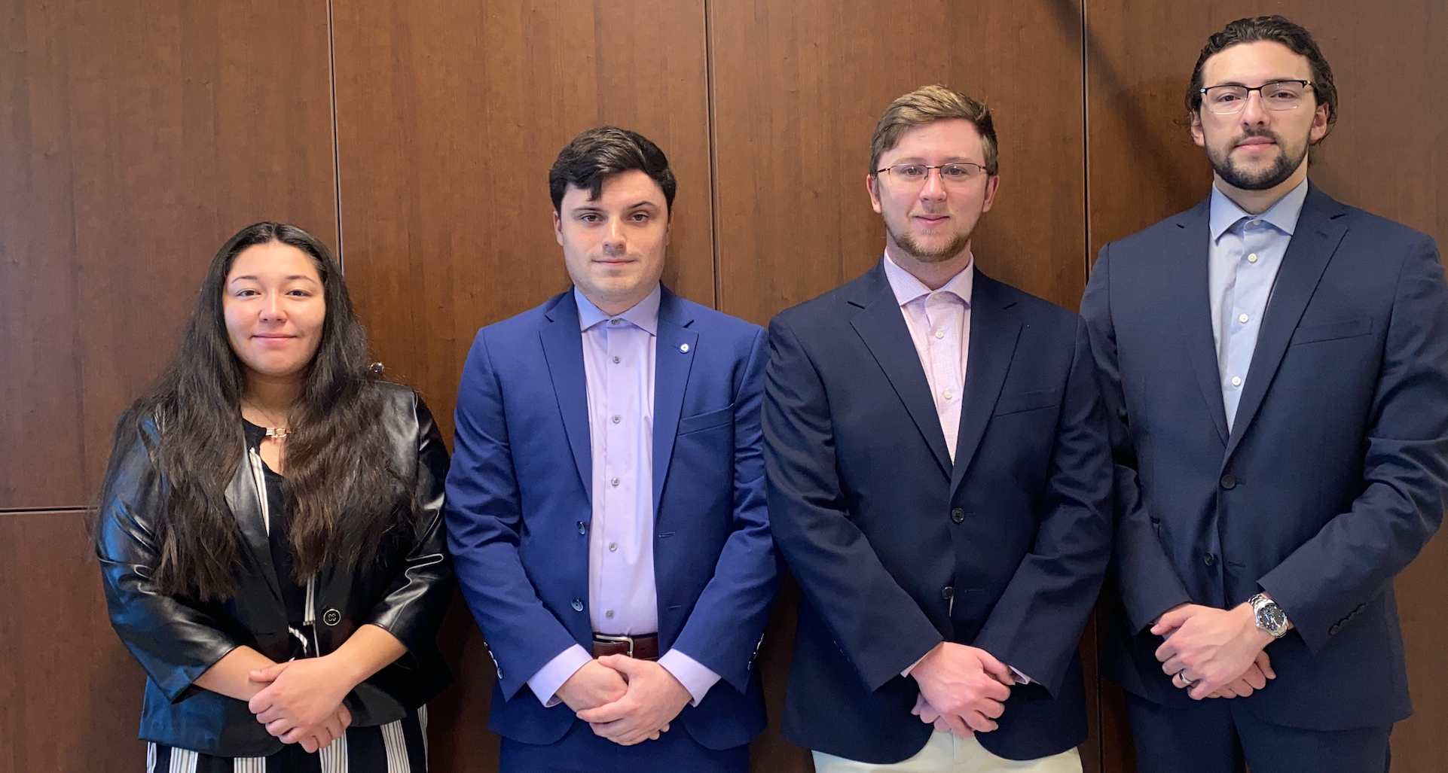
Meet the Team
Natalie Gonzalez
Team Lead
Alex Reinert
Electronics Engineer
Devin Hoopes
Design Engineer
Ian Adelman
Simulation Engineer
3
Notes:
Natalie

Slide 4

The Problem
4
Notes:
Natalie

Slide 5
Workplace Injury [1]
5
Notes:
Natalie
https://www.forbes.com/home-improvement/moving-services/movers-and-packers-cost/

Slide 6
Problem Statement
Transporting heavy furniture up or down one flight of straight stairs is difficult and dangerous.
6
Notes:
Natalie

Slide 7

Design Overview
7

Slide 8
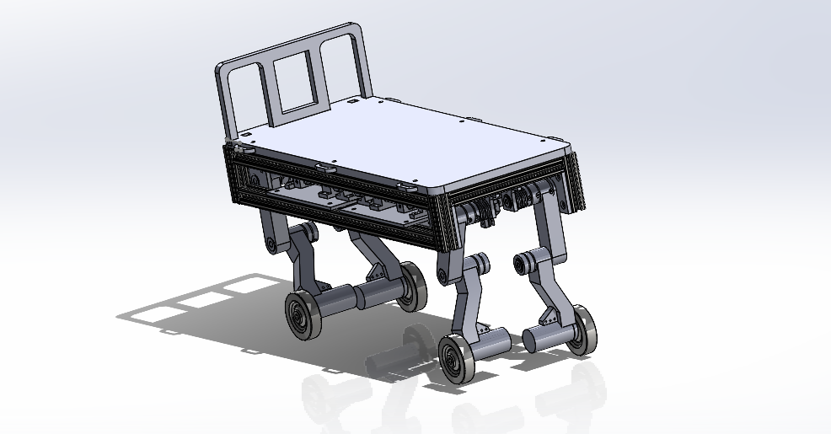
ATLAS Moving System
CORE DESIGN PRINCIPLE:
Locked Configuration on Power Loss
Motor Block
Main Chassis
Leg Assembly
Full ATLAS System
Built to ¼ scale
8
Notes:
Ian MENTION QUARTER SCALE
If time smaller arrows or no arrow tips,
Highlight sub-sections, differentiate Motor Block and Chassis
Move Motor Block up to show it is first
Put arrows/callouts in order
Explain
Each leg is a 2 degree of freedom manipulator with a wheel at the end effector with a standard inverse kinematic solution

Slide 9

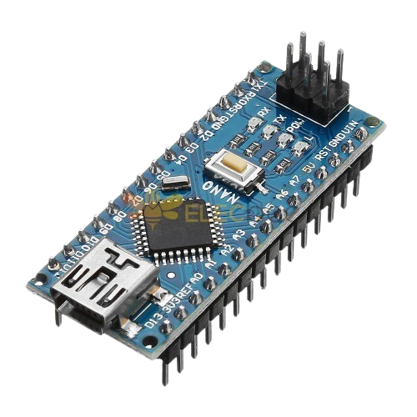



Remote Control System
Satisfies Specification:
[3.1.1]
Laptop With ROS
Arduino
Connect RP2040
Logitech Controller
Connects via Wi-Fi
9
Notes:
This is first, talk about user
Control is part of system overview
Show actual controller, plans for control (chip)
Flowchart for latency

Slide 10
Mode Selection
Up D-Pad Double Pressed
Ascending
Mode
Wait for user input
Mode Selection
Left or Right on D-Pad Double Pressed
Flat Mode Direction
Down D-Pad Double Pressed
Descending
Mode
10
Notes:
Natalie

Slide 11
Ascending mode
Front 2 legs step up and back 2 legs drive forward
Stop/
Brake
A-Button Pressed
A-Button Released
User Input
Iterate all 4-leg stepping
Stop/Brake
Ascending
Mode
B-Button Pressed
B-Button Released
Back 2 legs step up and front 2 legs drive forward
X-Button Pressed
X-Button Released
Stop/Brake
11
Notes:
Natalie

Slide 12
Flat Mode
If Right, set Forward
A-Button Pressed
Drive
Forward
A-Button Released
Flat Mode
User Input
Stop/Brake
If Left, set Backward
A-Button Pressed
Drive
Backward
A-Button Released
12
Notes:
Natalie

Slide 13
Descending Mode
Back 2 legs iterate step down and front 2 legs drive backward
Stop/Brake
A-Button Pressed
A-Button Released
User Input
Iterate all 4-leg stepping down
Stop/Brake
Descending
Mode
B-Button Pressed
B-Button Released
Front 2 legs iterate step down and back 2 legs drive backward
Stop/Brake
X-Button Pressed
X-Button Released
13
Notes:
Natalie
Picture of what buttons are beign pressed for what staet

Slide 14
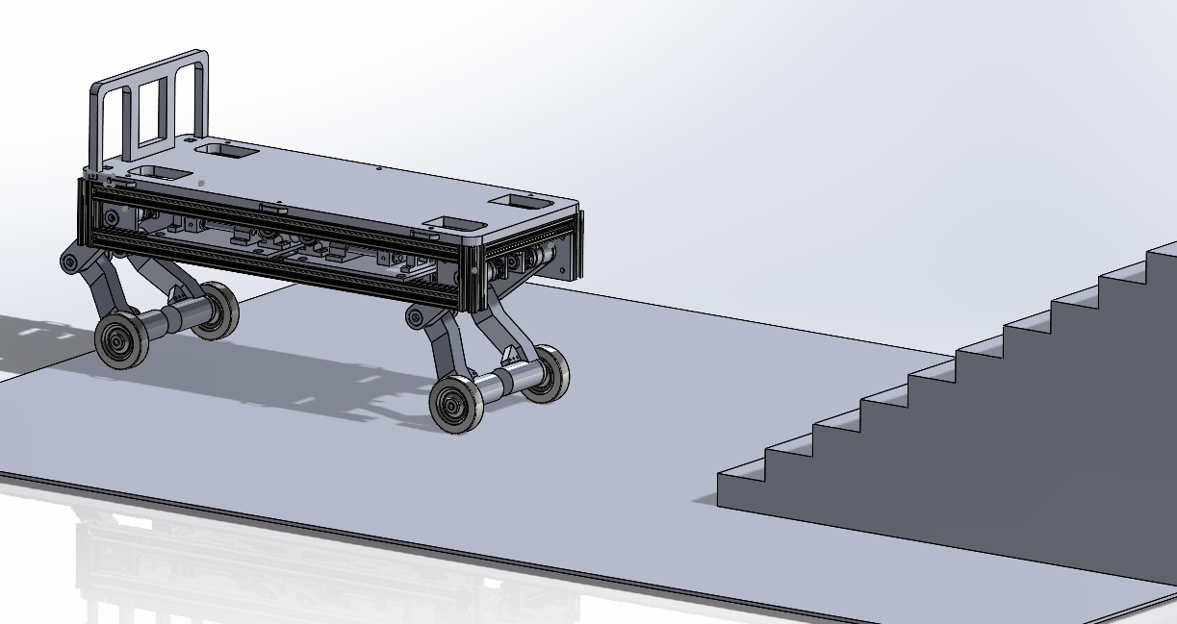
Walk Cycle - Approach
A
ATLAS System Approaching Stairs
14
Notes:
Ian
User operation -> Robot does…
Button – robot moves to programed trajectory
Robot is given position in task space – inverse kinematics gives joint angles for robot to move to the position

Slide 15
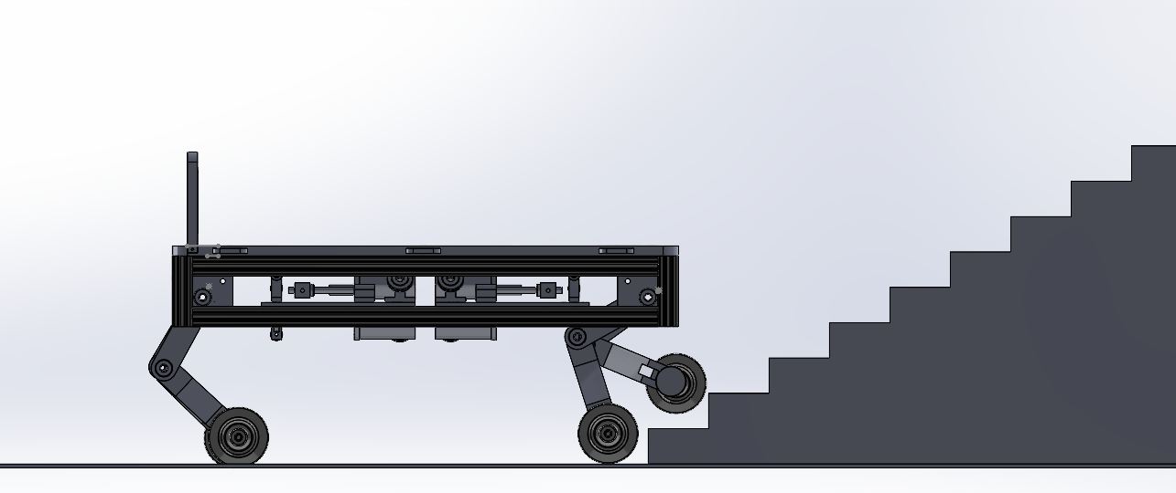
Walk Cycle – First Step
A
ATLAS System Stepping First Foot Onto Stairs
15
Notes:
Ian
More explanation on cubic splines rockets = ? Robot = good
Might be a bonus section?
In what terms is everything mentioned?
Why do we care?

Slide 16
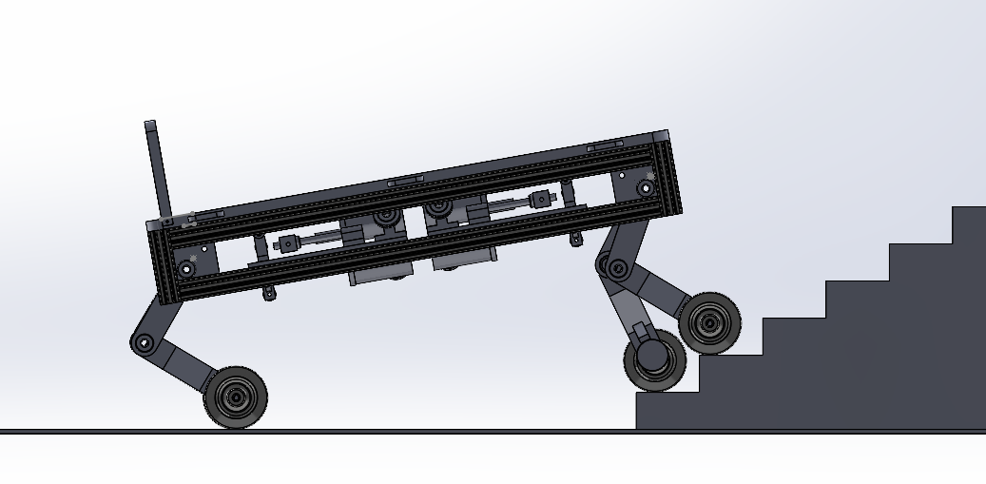
Walk Cycle – Second Step
A
ATLAS System Stepping Second Foot Onto Stairs
16
Notes:
Ian

Slide 17
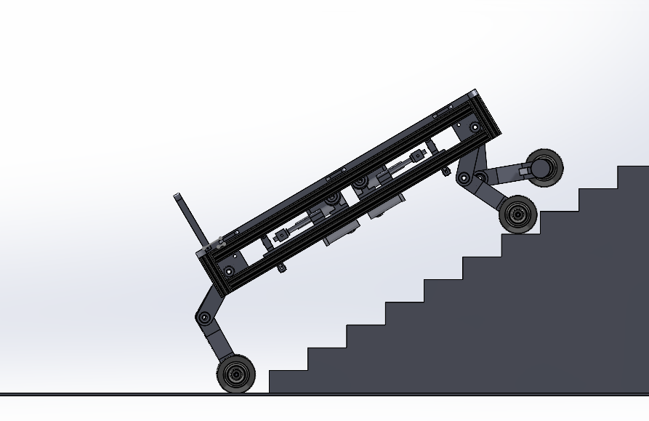
Walk Cycle – Back Feet Reach Stairs
B
ATLAS System Mid Ascent
17
Notes:
Ian

Slide 18
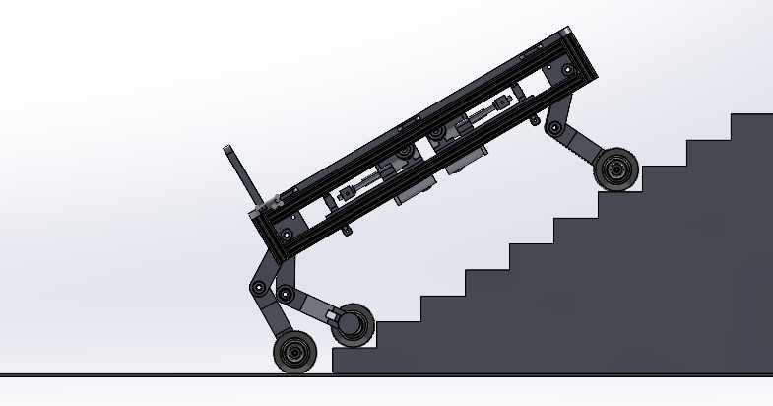
Walk Cycle – Back Foot Takes Step
B
ATLAS System Back Feet Stepping Onto Stairs
18
Notes:
Ian

Slide 19
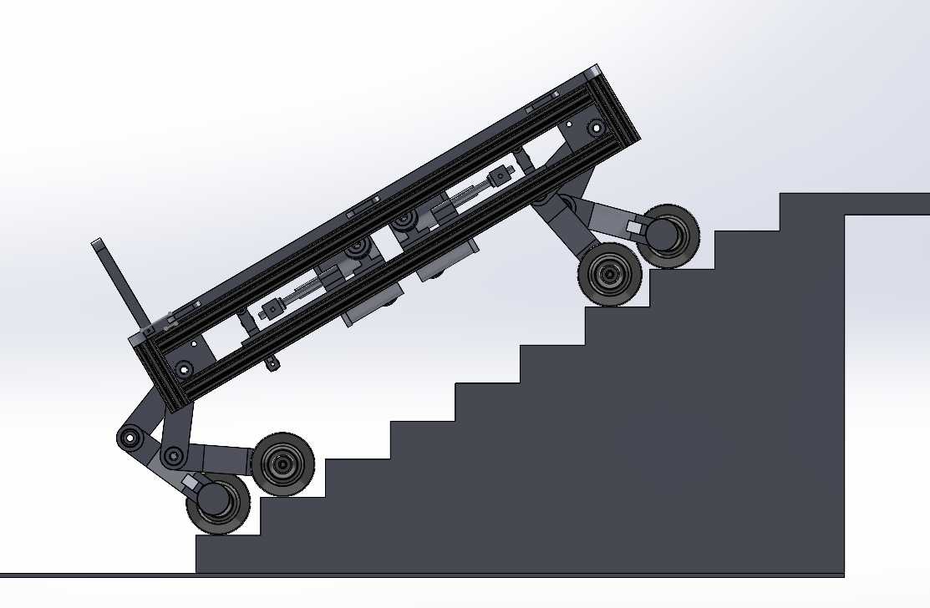
Walk Cycle – All Feet Climbing
B
ATLAS System Walking with All Legs
19
Notes:
Ian

Slide 20
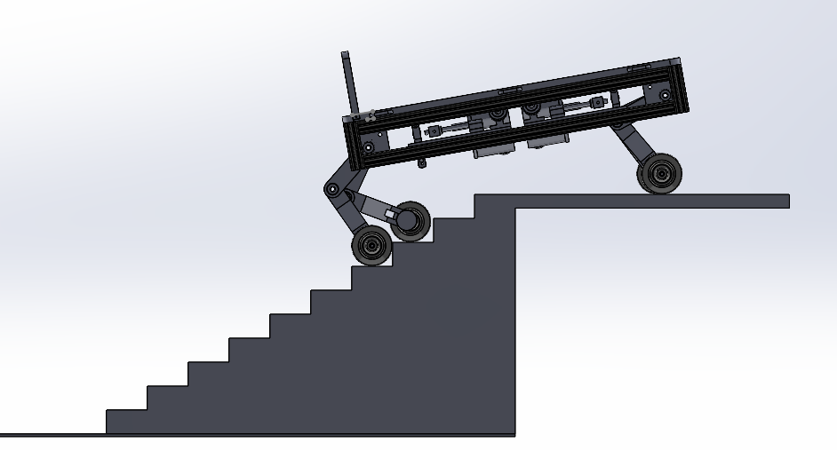
Walk Cycle – Front Feet Reach Top
X
ATLAS System Finishing Ascent
20
Notes:
Ian

Slide 21
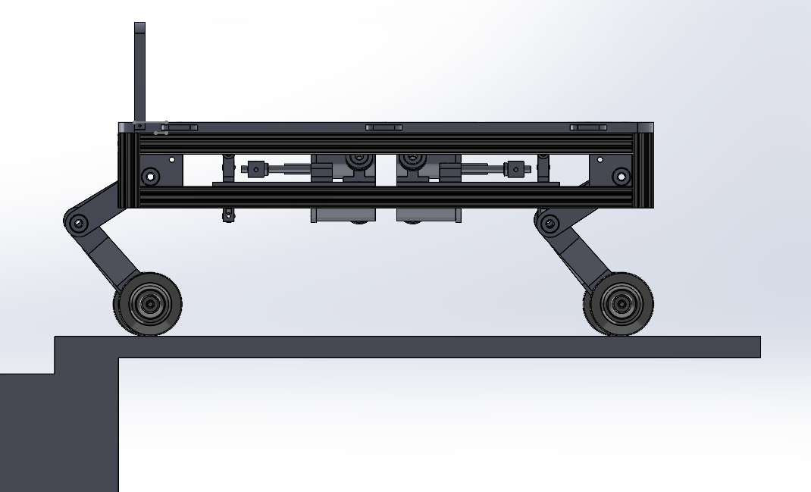
Walk Cycle – Cycle Complete
Satisfies Requirement:
[1.1]
A
ATLAS System at Top of Staircase
21
Notes:
Ian

Slide 22
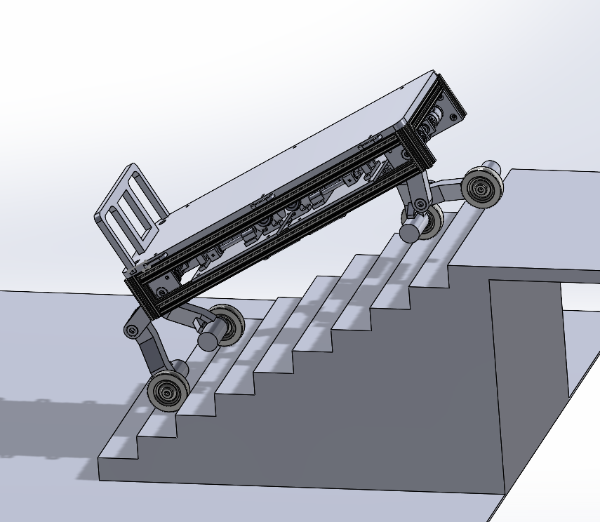

Proof of Stability
Satisfies Specification:
[3.2.1]
Foot
Center of Mass
Support Polygon
System Mid Step
22
Notes:
Devin
Goes under legs sub-system
Label support polygon
Plygon first then robot

Slide 23
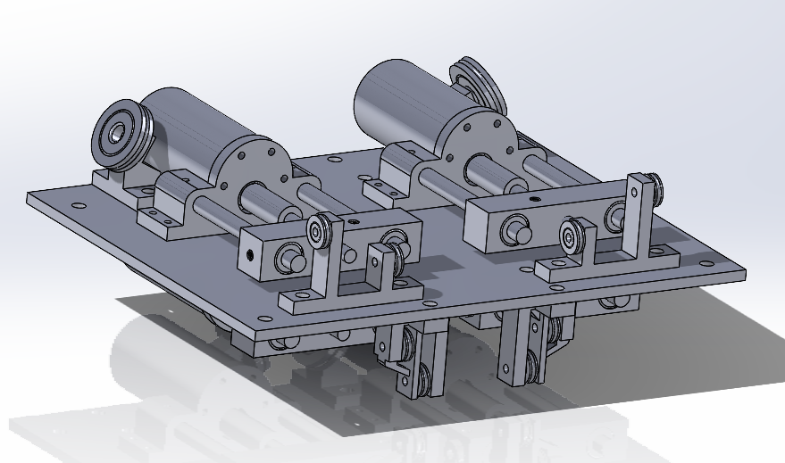
Motor Block – Overview
Motor
Back Pulley
Screw Plate
Upper Guide Pulleys
Lower Guide Pulleys
Motor Block System
23
Notes:
Devin
Adjust arrows to show
Arrows can be angled

Slide 24
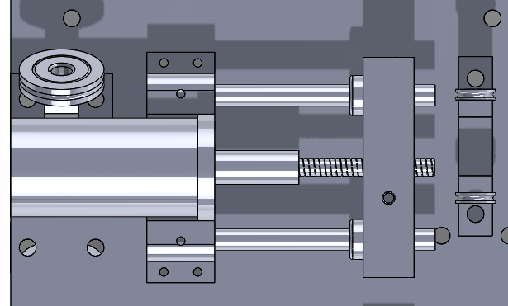
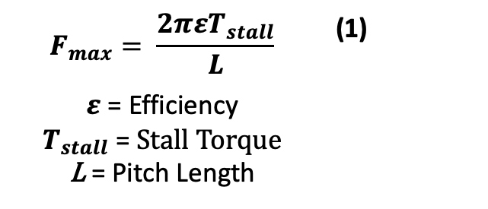
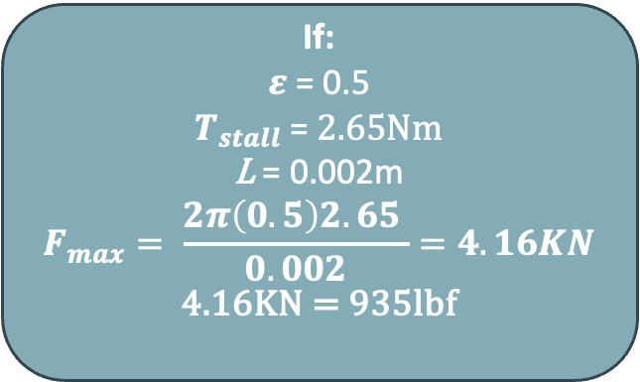
Motor Block – Screw Plate
CORE DESIGN PRINCIPLE:
Locked Configuration on Power Loss
Top View of Motor-Screw System
$$F_{max}= \frac{2πεT_{stall}}{L}$$ | (1)
$ε$ = Efficiency $$T_{stall} \text{=} Stall Torque$$ L = Pitch Length
If:
$ε$ = 0.5
$$T_{stall} \text{=} 2.65Nm$$
L = 0.002m
$$F_{max}= \frac{2π\left(0.5\right)2.65 }{0.002}=4.16KN$$
4.16KN = 935lbf
Motor
Lead Screw
Screw Plate
24
Notes:
Devin

Slide 25
Motor Block – Cable Routing Mockup
Legend
Pulling
Slacking
Cable Routing
25
Notes:
Devin
Add callouts to cables - pulling pushing cable

Slide 26
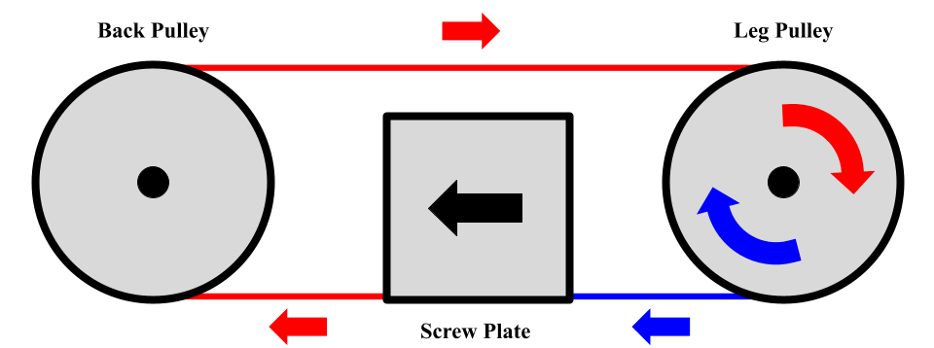
Motor Block – Pulley System
Legend
Pulling
Slacking
Block-Pulley System
26
Notes:
Devin

Slide 27
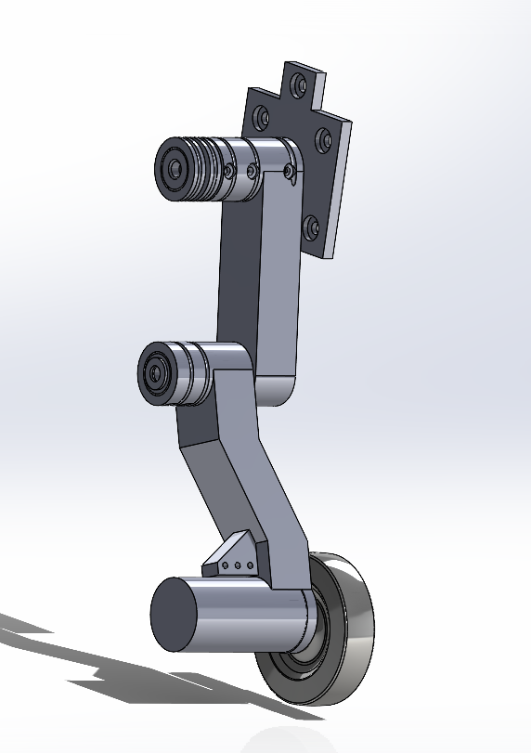
Leg Assembly - Overview
Mounting Plate
Upper Pulleys
Upper Leg Segment
Lower Leg Segment
Motor
Wheel
Leg System
27
Notes:
Devin

Slide 28
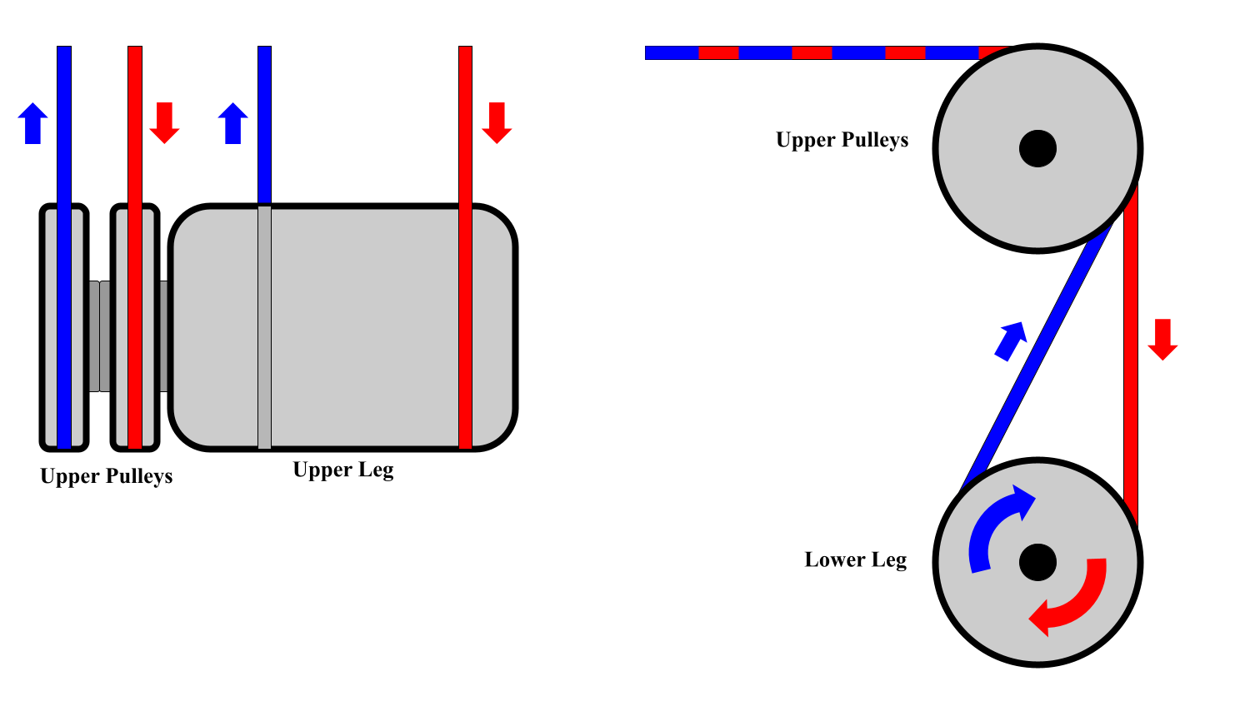

Leg Assembly – Pulley Configuration
Top View
Side View
28
Notes:
Devin
Label push and pull
Power analysis/Torque

Slide 29
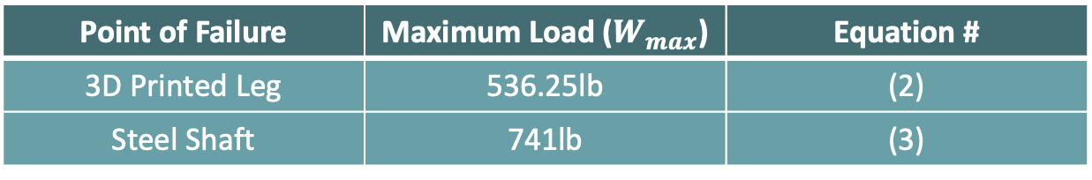
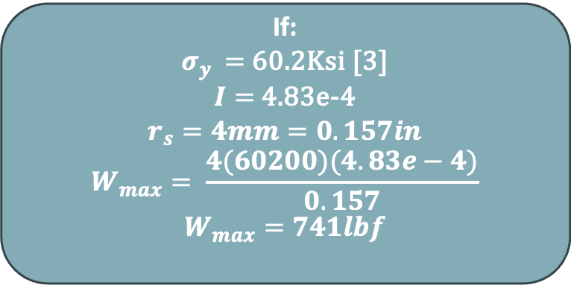
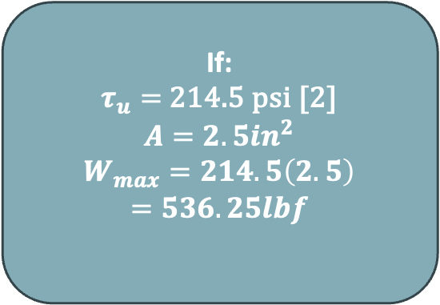
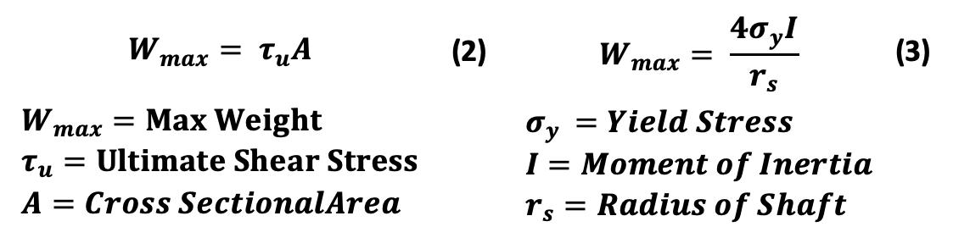
Structural Analysis - Leg
Point of Failure | Maximum Load ($W_{max}$) | Equation #
3D Printed Leg | 536.25lb | (2)
Steel Shaft | 741lb | (3)
$$W_{max}= τ_{u}A$$ | (2) | $$W_{max}= \frac{{4σ}_{y}I}{r_{s}}$$ | (3)
$$W_{max}=Max Weight \\ τ_{u}=Ultimate Shear Stress \\ A=Cross SectionalArea$$ |  | $$σ_{y }=Yield Stress \\ I=Moment of Inertia \\ r_{s}=Radius of Shaft$$
If:
$τ_{u}=$ 214.5 psi [2]
$$A=2.5in^{2}$$
$$W_{max}=214.5\left(2.5\right)$$
$$=536.25lbf$$
If:
$σ_{y }=$ 60.2Ksi [3] $I=$4.83e-4 $$r_{s}=4mm=0.157in$$
$$W_{max}= \frac{4(60200)(4.83e−4)}{0.157}$$
$$W_{max}=741lbf$$
29
Notes:
Devin
Distribute analysis to relevant
Put numbers into the equations ie. Solve
Define vars

Slide 30

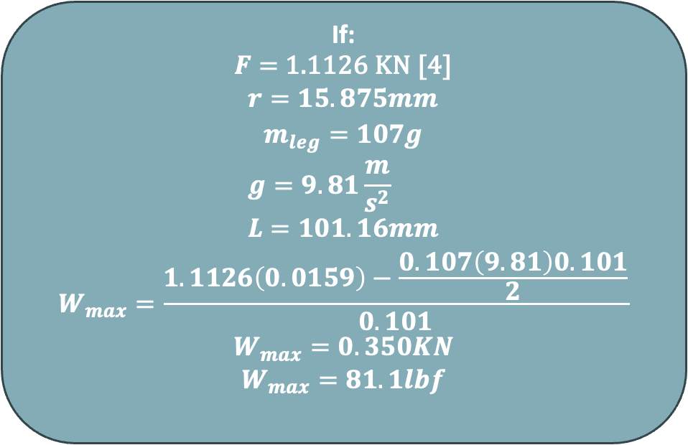
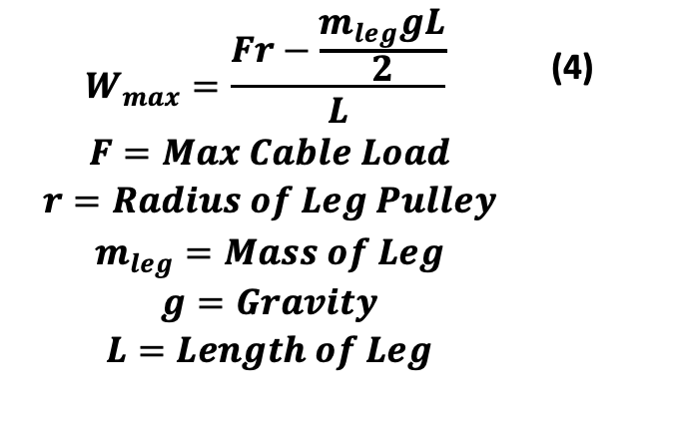
Structural Analysis - Cable
Justifies Specification
[1.1.1]
Point of Failure | Maximum Load ($W_{max}$) | Equation #
Cable | 81.1lb | (4)
$$W_{max}=\frac{Fr−\frac{m_{leg}gL}{2}}{L}$$ | (4)
$$F=Max Cable Load$$ $$r=Radius of Leg Pulley$$ $$m_{leg}=Mass of Leg$$ $$g=Gravity$$ $$L=Length of Leg$$
If:
$F=$ 1.1126 KN [4]
$$r=15.875mm$$
$$m_{leg}=107g$$
$$g=9.81\frac{m}{s^{2}} \\ L=101.16mm$$
$$W_{max}=\frac{1.1126\left(0.0159\right)−\frac{0.107\left(9.81\right)0.101}{2}}{0.101}$$
$$W_{max}=0.350KN$$
$$W_{max}=81.1lbf$$
30
Notes:
Devin
Distribute analysis to relevant
Put numbers into the equations ie. Solve
Define vars

Slide 31
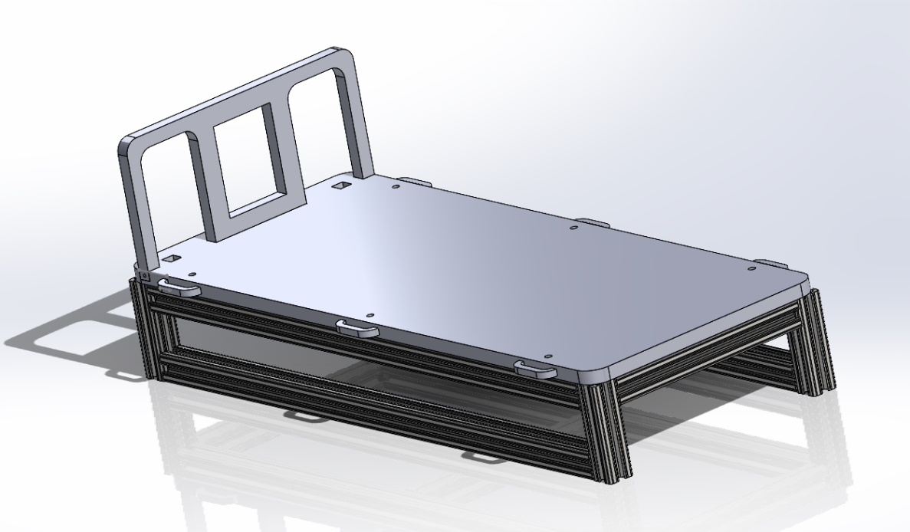
Main Chassis - Overview
Main Chassis
Backing
Cargo Bed
Strap Bracket
Aluminum Support Structure
31
Notes:
Devin

Slide 32
Main Chassis - Sizing
Satisfies Requirement(s):
[1.2.1], [1.3.1], [2.1.1], [2.2.1]
Maximum Dimensions: L 30in x W 16.5in
Minimum Dimensions
L 22.28in x W 8.9in
Main Chassis
25in
10in
32
Notes:
Devin

Slide 33
Main Chassis - Weight
Satisfies Specification:
[1.1.1]
2.5lb Weight (Couch)
Maximum Weight
81lb
Design Weight
17.81lb
Main Chassis
33
Notes:
Devin
Make clear 11.4 is system and show 2.5 lb is the load weight (red Arrow load)
Structural analysis before this

Slide 34
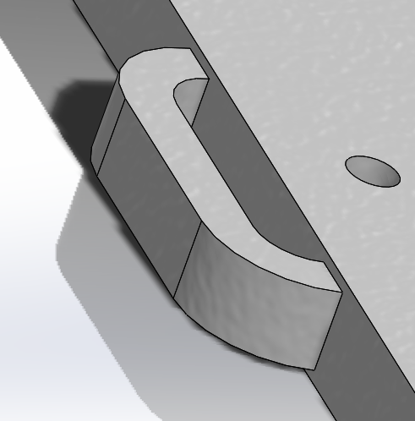
Main Chassis - Brackets
0.4in
0.25in
Should Support 2.5lbs Each
Bracket Cross Section
Main Chassis
34
Notes:
Devin

Slide 35

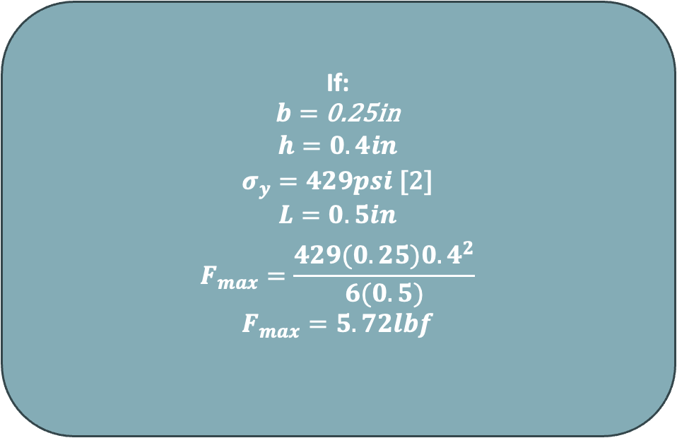
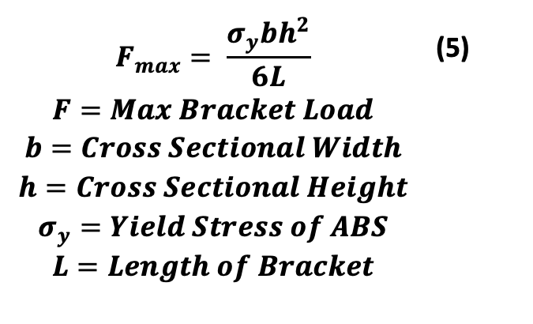
Structural Analysis - Brackets
Satisfies Specification:
[3.3.1]
Point of Failure | Maximum Load ($W_{max}$) | Equation #
Bracket | 5.72 | (5)
$$F_{max}= \frac{σ_{y}bh^{2}}{6L}$$ | (5)
$$F=Max Bracket Load$$ $$b=Cross Sectional Width$$ $$h=Cross Sectional Height$$ $$σ_{y}=Yield Stress of ABS$$ $$L=Length of Bracket$$
If:
$b=$ 0.25in
$$h=0.4in$$
$σ_{y}=429psi$ [2] $$L=0.5in$$
$$F_{max}=\frac{429(0.25){0.4}^{2}}{6(0.5)}$$
$$F_{max}=5.72lbf$$
35
Notes:
Devin
Distribute analysis to relevant
Put numbers into the equations ie. Solve
Define vars

Slide 36
Electronics
36
Notes:
Alex

Slide 37
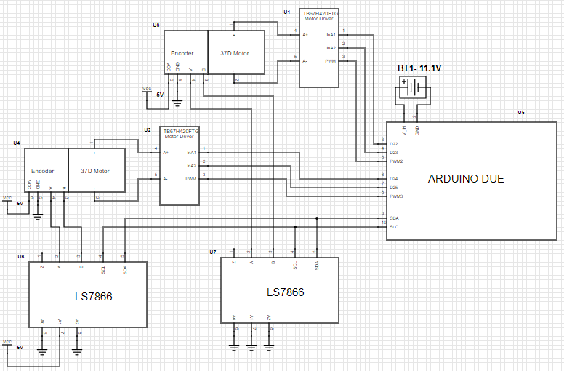
Electrical Schematic
Motor
Battery
Motor Driver
Quadrature Decoder
Electrical Schematic
37
Notes:
Alex
Voltage is 11.1V
Note location on robot

Slide 38
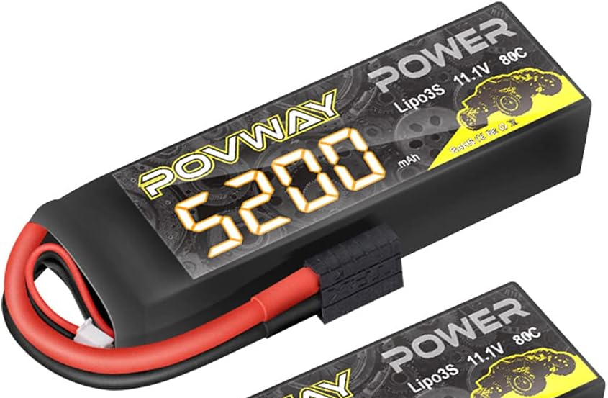
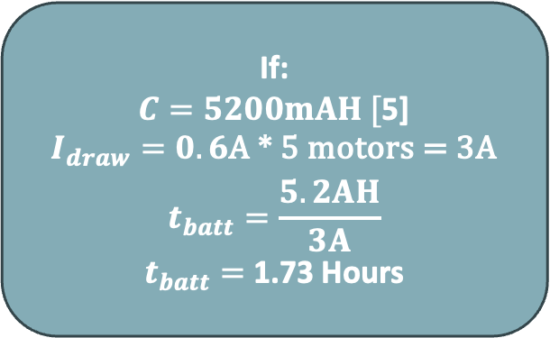
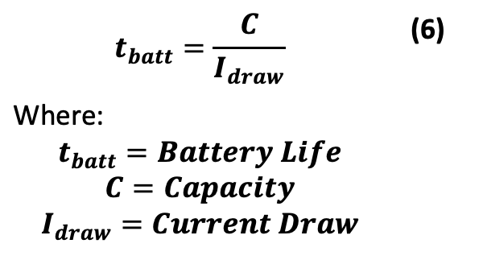
Battery
Satisfies Specifications:
[1.4.1] [1.4.2]
$$t_{batt}=\frac{C}{I_{draw}}$$ | (6)
Where: $$t_{batt}=Battery Life$$ $$C=Capacity$$ $$I_{draw}=Current Draw$$
If:
$C=5200mAH [$5]
$I_{draw}=0.6$A * 5 motors = 3A
$$t_{batt}=\frac{5.2AH}{3A}$$
$t_{batt}=$1.73 Hours
11.1V 5200mAH
Rechargeable LiPo Battery
38
Notes:
Alex
Battery Math

Slide 39
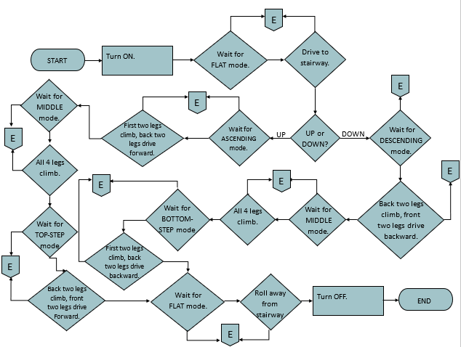
Robot Flowchart
39
Notes:
Alex
Zoom in and show “sub-steps”

Slide 40
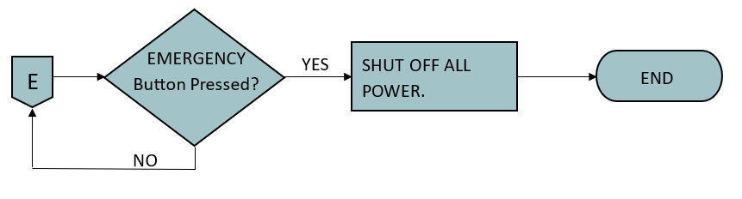
Robot Flowchart: Emergency Stop
Robot Flowchart
Satisfies Specification:
[3.1.2]
40
Notes:
“No” arrow pull downt then go left

Slide 41
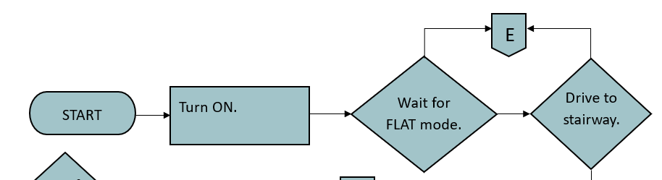
Robot Flowchart - Start
To Next Slide
41
Notes:
Alex
Zoom in and show “sub-steps”

Slide 42
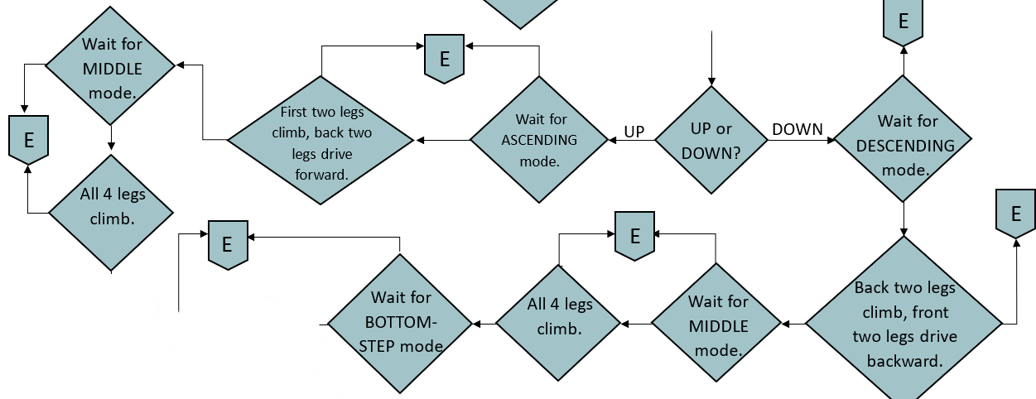
Robot Flowchart – Climbing
From Previous Slide
To Next Slide
42
Notes:
Alex
Zoom in and show “sub-steps”

Slide 43
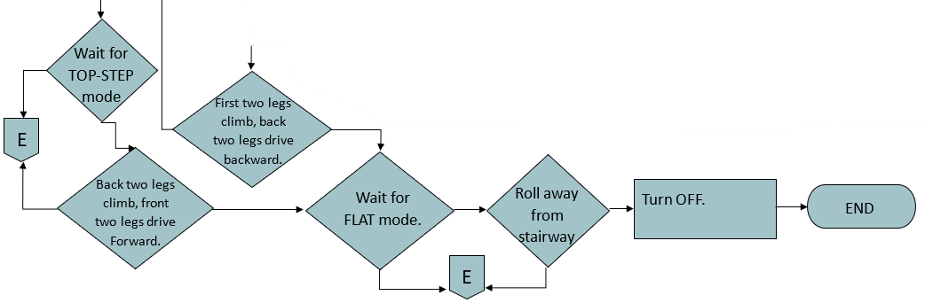
Robot Flowchart - End
From Previous Slide
43
Notes:
Alex
Zoom in and show “sub-steps”

Slide 44

Project Management
44
Notes:
Natalie

Slide 45
Components
Electrical Components
11.1V 5200mAH LiPo Battery
Structural Components
T-slotted Framing
Shafts and Bearings
Lead Screws
Arduino Due
LS7866 Quadrature Counter
TB67H420FTG Motor Driver
PCB
T Slot Fasteners
T Slot Structural
Shafts (8mm)
Skateboard Bearings
8mm Linear Bearings
Shafts (4mm)
Rotary Bearings

Slide 46
Budget
46
Notes:
Natalie
Show budget
Do pi chart for budget against total (digressionary funds)
Do that -
Maybe have different slides for:
- Custom Components
- Purchased Components - Fasteners? (can probably be included in purchased components)
We should avoid listing off the components, but maybe mention a few important details like which ones are real budget eaters or which parts we are acquiring from the school

Slide 47
Gantt Chart for Next Semester
Week | 1 | 2 | 3 | 4 | 5 | 6
Component Ordering
Stairs Model Assembly
System Assembly
Electronics Assembly
Software
Gait Testing
Gantt Chart Part 1 of 2
*Continued on Next Slide
47
Notes:
Natalie
This might be its own section tbh, especially if they want it week by week? We could also break it down into phases
Make 2 slides

Slide 48
Gantt Chart for Next Semester
Week | 6 | 7 | 8 | 9 | 10 | 11 | 12 | 13
Software
Gait Testing
Stress Testing
Couch Model Assembly
Requirements Testing
Paper
Presentation
Gantt Chart Part 2 of 2
48
Notes:
Natalie
This might be its own section tbh, especially if they want it week by week? We could also break it down into phases
Make 2 slides

Slide 49

Thank You
Special thanks to Dr. Douglas Isenberg and Dr. Jonathan Adams
49
Notes:
Natalie
Thank you – Acknowledgements

Slide 50
References
[1] “Transportation and material moving workers experienced 184,470 injuries and illnesses in 2018 : The Economics Daily: U.S. Bureau of Labor Statistics.” Available: https://www.bls.gov/opub/ted/2019/transportation-and-material-moving-workers-experienced-184470-injuries-and-illnesses-in-2018.htm
[2] “All About ABS 3D Printing Filament: Materials, Properties, Definition.” Available: https://www.xometry.com/resources/3d-printing/abs-3d-printing-filament/
[3] “Carbon Steel Properties | View Carbon Steel Material Properties & Mechanical Properties - E-Z LOK.” Available: https://www.ezlok.com/carbon-steel-properties
[4] “Bicycles/Maintenance and Repair/Cables and Housings - Wikibooks, open books for an open world.” Available: https://en.wikibooks.org/wiki/Bicycles/Maintenance_and_Repair/Cables_and_Housings
[5] “Amazon.com: POVWAY 3S Lipo Battery, 5200mAh 11.1V 80C RC Lipo Battery Softcase with Trxazas Plug for RC Car RC Plane DJI Quadcopter RC Airplane RC Helicopter RC Truck Boat - 2 Pack : Toys & Games.” Accessed: Dec. 07, 2023. [Online]. Available: https://www.amazon.com/POVWAY-Softcase-Quadcopter-Airplane-Helicopter/dp/B08X4D78PT?th=1
50

Slide 51
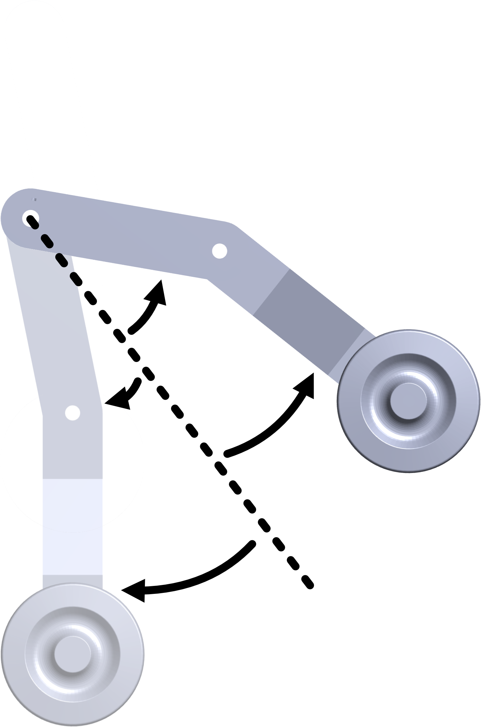
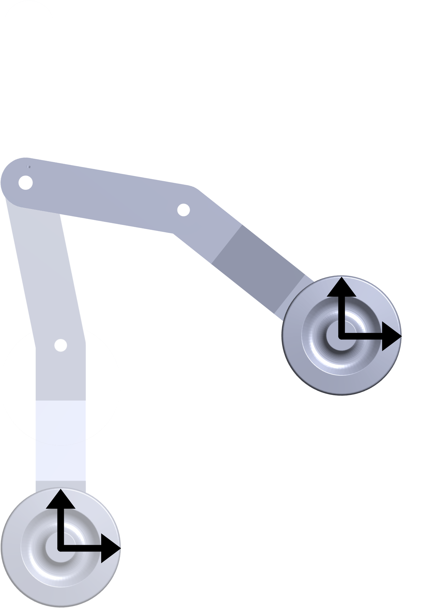
Inverse Kinematics Diagram

Slide 52
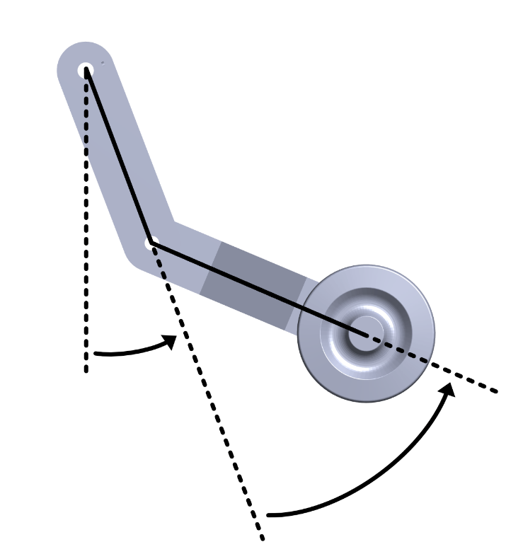
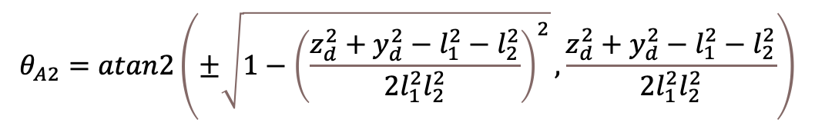
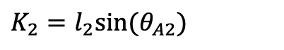
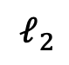
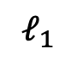
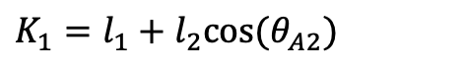
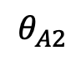
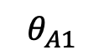
Planar Two Link IK solution
$$θ_{A2}=atan2\left(±\sqrt{1−{\left(\frac{z_{d}^{2}+y_{d}^{2}−l_{1}^{2}−l_{2}^{2}}{2l_{1}^{2}l_{2}^{2}}\right)}^{2}},\frac{z_{d}^{2}+y_{d}^{2}−l_{1}^{2}−l_{2}^{2}}{2l_{1}^{2}l_{2}^{2}}\right)$$
$$𝓁_{1}$$
$$𝓁_{2}$$
$K_{1}=l_{1}+l_{2}cos⁡(θ_{A2})$
$K_{2}=l_{2}sin⁡(θ_{A2})$
$$θ_{A1}$$
$$θ_{A1}=atan2\left(z_{d},y_{d}\right)−atan2\left(K_{2},K_{1}\right)$$
$$θ_{A2}$$
52
Notes:
Devin
Adjust arrows to show
Arrows can be angled

Slide 53
Components
Item | Price | Quantity | Vendor
T-slotted Framing 1”x1”x6’ | $15.90 | 2 | McMaster Carr
2mm Lead, 200x8mm Lead Screws x2 | $12.99 | 4 | Amazon
Shafts (8mm x 300mm) x2 | $9.99 | 1 | Amazon
Skateboard Bearings (8mm) X30 | $15.99 | 1 | Amazon
8mm Linear Bearings x15 | $11.99 | 2 | Amazon
Shafts (4mm) x5 | $7.99 | 1 | Amazon
Bearings (4mm) x20 | $9.49 | 1 | Amazon
T Slot Fastener 1” x4 | $5.45 | 8 | McMaster Carr
T Slot Structural Brackets | $9.23 | 10 | McMaster Carr
11.1V 5200mAH LiPo Battery x2 | $66.99 | 1 | Amazon
Arduino Due | $0 | 1 | ERAU Robotics Lab
SN74KS93N Binary Counter | $3.48 | 12 | Digikey
TB67H420FTG Motor Driver | $10.99 | 12 | Pololu
PCB | $100* | 1 | Estimate
Total Cost | $627.73

Slide 54
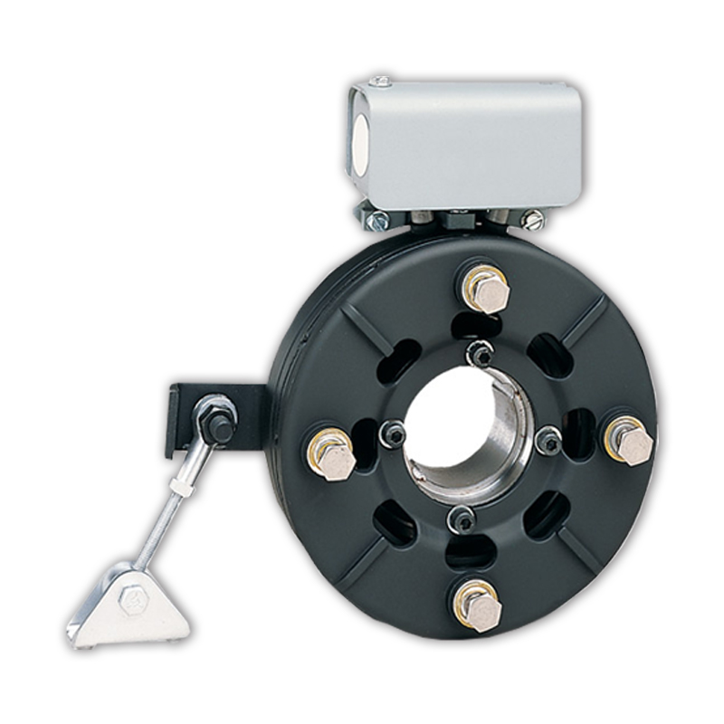
Holding Torque of Wheels
Zero Current Holding Torque should be enough
If not, we are looking into physical shaft brakes

Slide 55
Climbing Speed
5 second step time : 6rpm
We can climb 5 seconds per leg per step
20 seconds per step total

Slide 56
Stair Dimensions
Minimum:
Step height
Test Case
Step height
Step Height
Step Height
Tread depth
Tread depth
Tread Depth
Flat
Depends on system balance
1.75in
3in
~4in
No max

Slide 57
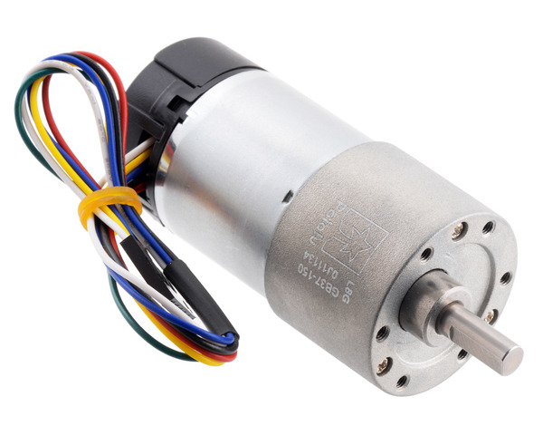

Full Scale Plans - Motor
Minimum Torque
3.25Nm
Motor Torque
4.81
Pololu 37D
150:1 Metal Gear Motor

Slide 58
Full Scale Plans - Cable
Required Force
1150lb
Cable Max Force
1300lb
¼”
Ultra Flexible Wire Rope For Lifting

Slide 59

Joint Angles: no control

Slide 60

Joint Angles: no control

Slide 61

Joint Angles: with control

Slide 62




Non-Backdrivability
Satisfies Specification:
[3.1.2]
62
Notes:
CONOPS slides here, Walking Slides

Slide 63

Team Noteboard/Graphic Design Corner
Final Checks:
Page numbers! We seem to be missing quite a few
Used this slide to create the bar on the right, delete before submission
Simplified Diagram
Size of each icon ->
Would we want something like this?
ATLAS
63

Slide 64
Team Noteboard/Graphic Design Korner
A
B
X
Y
2.6477955
ATLAS
64

